Slide 1
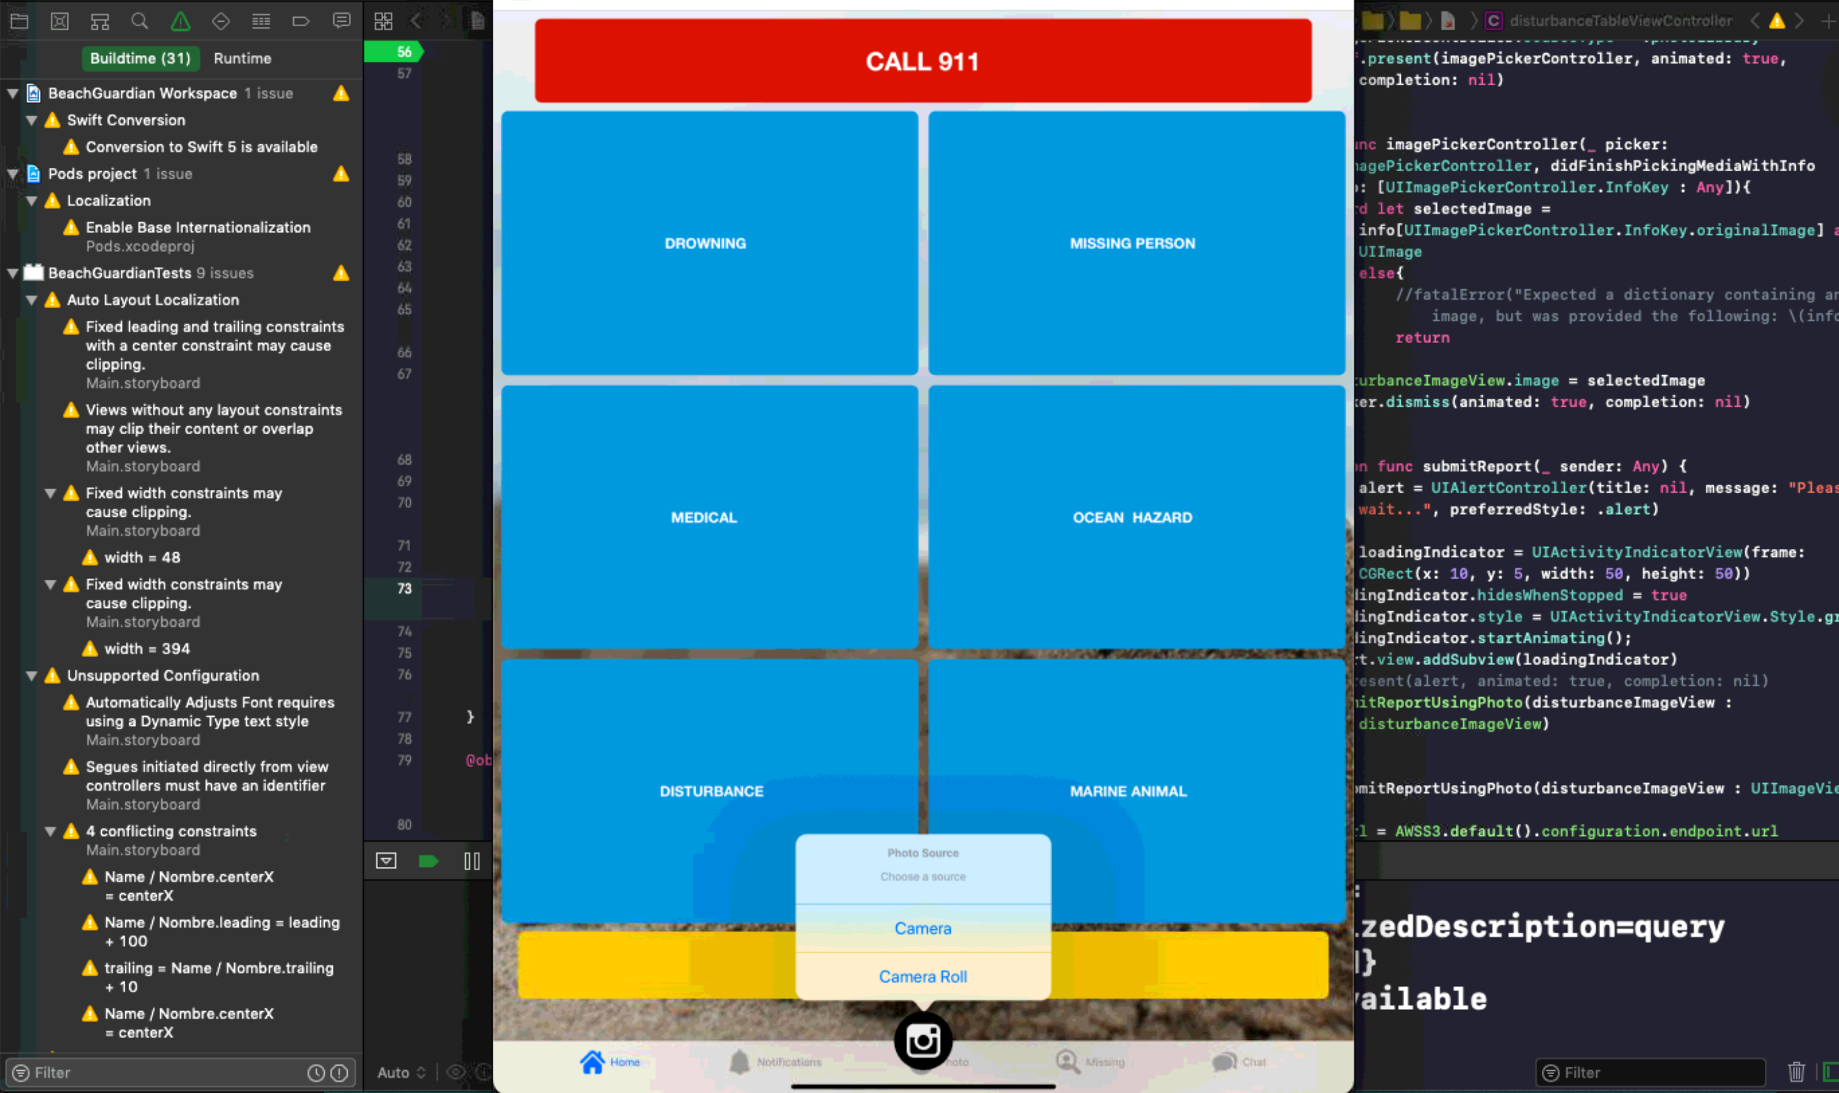
Edward – Week 11 (1)
Completed Tasks
Fixed iPad crash issue for main tab bar item
Cleaned up original photo icon from tab bar

Slide 2
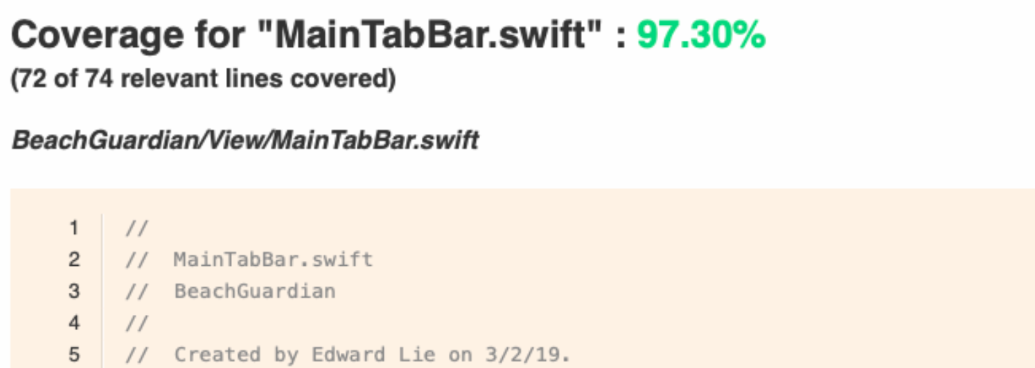
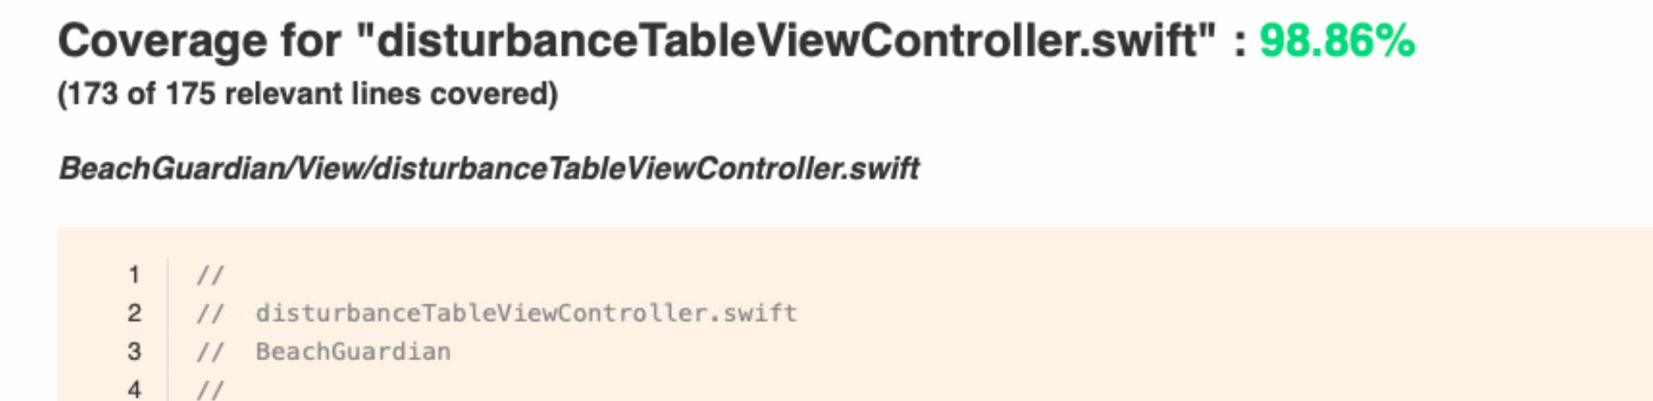
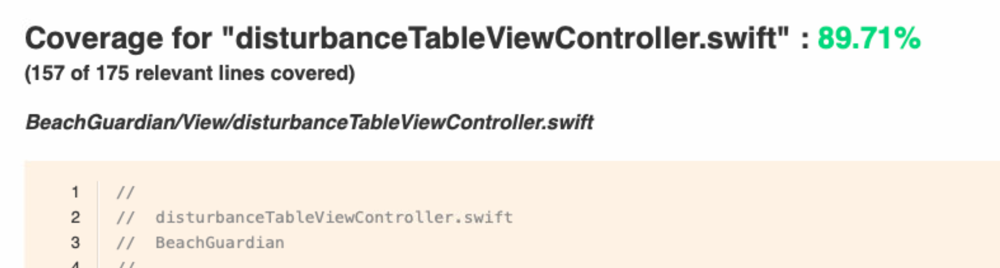
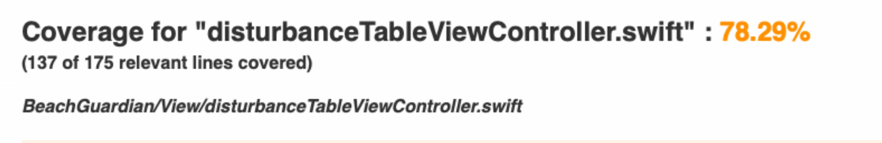
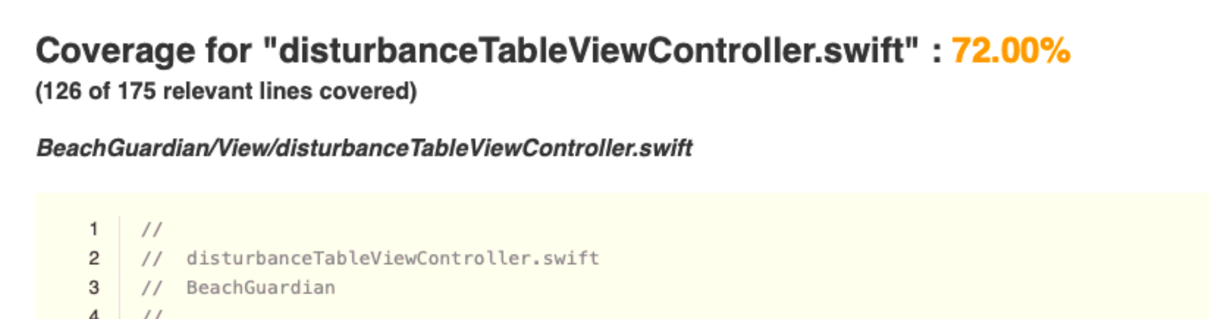
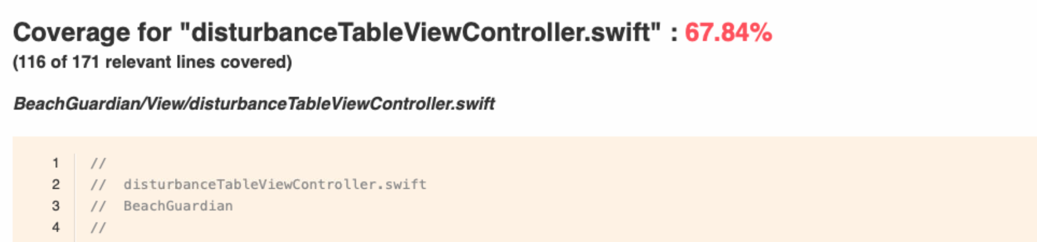
Edward – Week 11 (2)
Completed Tasks
Testing for S3 code at 97%+ for all S3-centered files
Increased code coverage in files:
AppDelegate
disturbanceForm
oceanHazardsForm
MainTabBar
Cleaned up code/migration of code

Slide 3
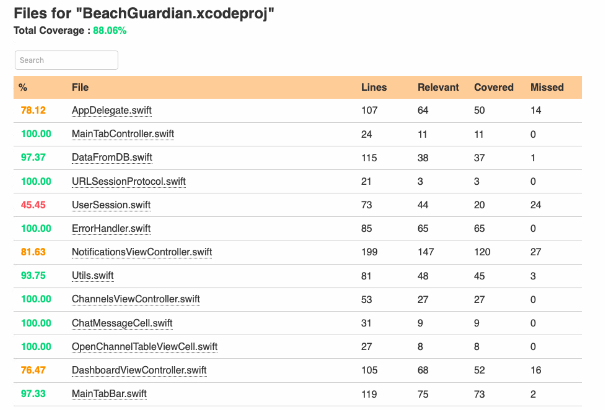
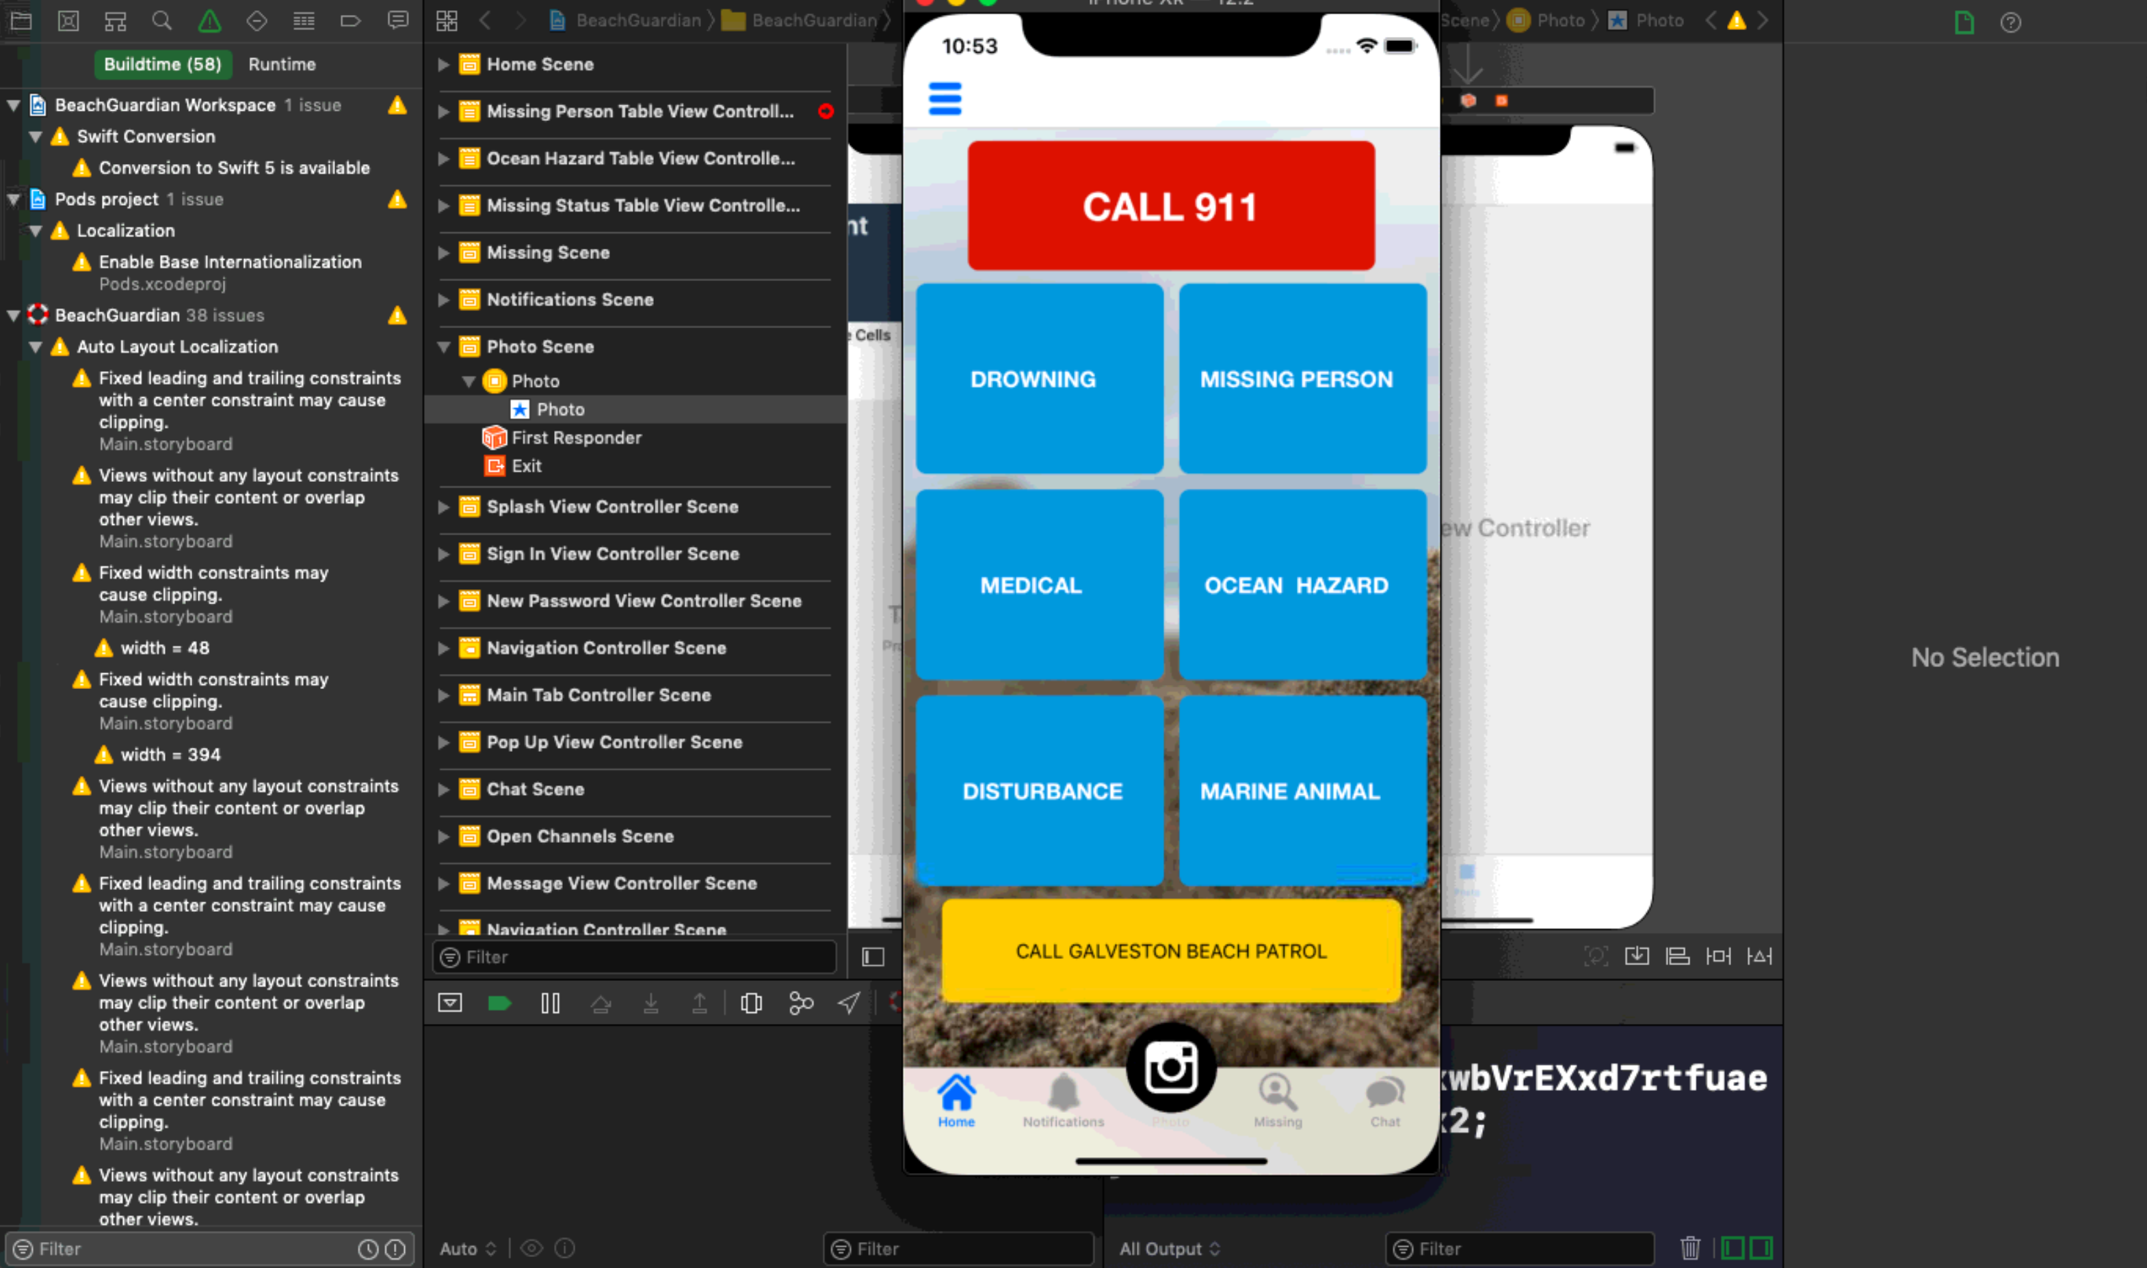
Edward Lie – Week 11 (3) In Progress Tasks
My week 12 goal is help with S3 in notifications and submitting of reports.
Will need to increase code coverage wherever it is low across all files.

